Slide 1
UNIT-I
DC CIRCUITS:
Basic definitions of voltages and current and power, Electrical circuit elements(R, L and C), Ohm’s Law, Voltage and current Sources, KCL and KVL , analysis of simple circuits with DC Excitation

Slide 2
Basic Definitions
Voltage:
Two types of charges : +ve and –ve charges
The forces of attraction will exist between these charges and requires some amount of work to be done for moving these charges against these forces to move a specific distance.
Charges possess a certain amount of potential energy because of separation
The difference in potential energy of the charges is called “Potential Difference”. It is denoted by V, and units is Volts
V= W/Q = J/C (or) volts V =dw/dq
One Volt is defined as the p.d between two points when one joule of energy is used to pass one coulomb of charge from one point to another

Slide 3
Current:
Free electrons in semi conductor materials moves randomly in all directions in the absence of external pressure (or) voltage
When external voltage is applied all the electrons move in particular direction depending on the polarity of applied voltage
Original direction is from –ve to +ve and the conventional direction is from +ve to –ve
“ Current is defined as the rate of flow of electrons in a semi conductive or conductive material”.
It is measured by number of electrons that passes a point in unit time
I = Q/t = dq/dt.
Unit is Ampere. One Ampere = 1 C/sec , 1 C = 6.25 X 10¹⁸ electrons

Slide 4
Power and Energy
Energy is the capacity for doing work (W or E)
Power is rate of change of energy (P)
Power P = Energy/time = W/t
P = dw/dt
P = dw/dq X dq/dt
P = V X I
Unit of power is Watts (or) J/S
One watt is the amount of power generated when one joule of energy is consumed in one second

Slide 5
Circuit
Circuit consists of majorly three components: (a) source (b) load or sink (c) Connecting wires
Purpose is to transfer the energy from source to load. Energy is transferred by means of current
If the current has complete path to flow in a circuit then the circuit is called closed circuit.
When the path is not closed, then the circuit is called open circuit
Interconnection of two or more simple circuit elements are called Electrical network
Circuit is characterized by voltage and current

Slide 6
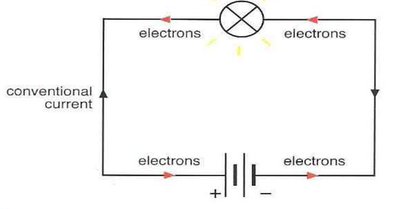

Slide 7
Classification of Network Elements
Active and Passive:
Active elements: capable of delivering the energy. Eg: batteries, cells, voltage and current sources
Average power >0
Passive elements: which absorbs the energy Eg: Resistors, Inductors and Capacitors
Average power<0

Slide 8
Bilateral and unilateral:
Bilateral: V-I relationship is same in either direction. Ex: R,L and C
Unilateral: different V-I relationship for different possible directions
Ex: Vacuum diodes, rectifiers etc
Linear and Non-Linear:
Linear: V-I curve is a straight line passing through zero
Non-Linear: not a straight line passing through zero
Lumped and distributed:
Lumped: small in size and physically separable
Distributed: which is not physically separable

Slide 9


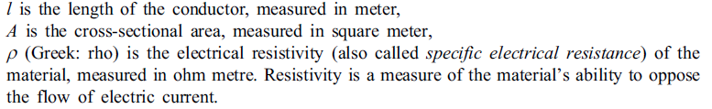
PASSIVE CIRCUIT ELEMENTS
Electrical Resistance:
Electrical resistance is a measure of the degree to which an object opposes an electric current through it.
It is a property which opposes the electric current.
The SI unit of electrical resistance is ohm (Ω).
The resistance of an object determines the amount of current through the object for a given voltage across the object.

Slide 10
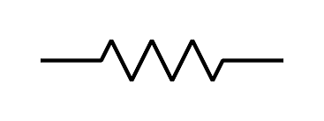

Resistor: A resistor is a two-terminal electrical or electronic component that resists an electric current by producing a voltage drop between its terminals in accordance with Ohms law
R = V / I
The electrical resistance is equal to the voltage drop across the resistor divided by the current through the resistor.
Energy in a Resistor Instantaneous power absorbed in the resistor,
p = vi = iR X i = i² R (in Watt)
Therefore, the energy converted into heat energy is given by,

Slide 11



Inductance:
Inductance is the property by virtue of which a circuit opposes the changes in the value of a time varying current flowing through it. Inductance causes opposition only to varying currents and does not cause any opposition to steady or direct current.
An electric current i flowing around a circuit produces a magnetic field and hence a magnetic flux φ through the circuit. The ratio of the magnetic flux to the current is called the inductance, or more accurately self-inductance of the circuit.
L = φ / I SI unit is Henry. Or Wb/A
Inductor: An inductor is a passive electrical device employed in electrical circuits for its property of inductance.
V = L di/dt
the current through an inductor cannot change instantaneously.

Slide 12
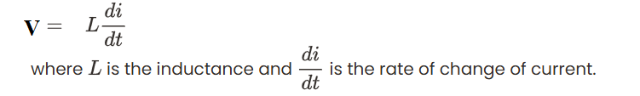
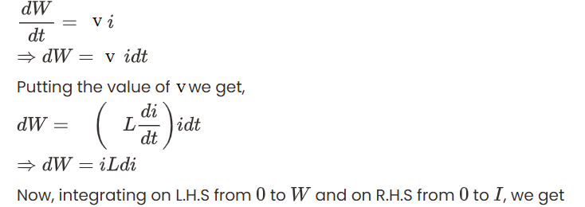
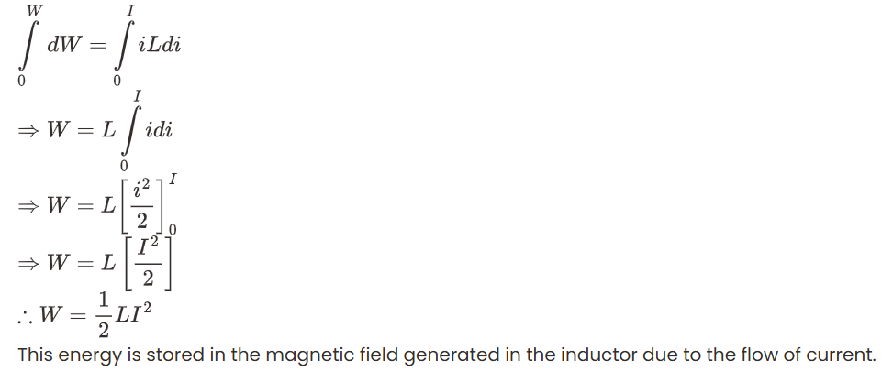
In order to pass current through the current, work must be done by the voltage source against this emf. The formula for rate of work done is given by,

Slide 13



Capacitance:
Capacitance is a measure of the amount of electric charge stored (or separated) for a given electric potential. The most common form of charge storage device is a two-plate capacitor. If the charges on the plates are +Q and Q, and V gives the voltage difference between the plates, then the capacitance is given by
The SI unit of capacitance is Farad; 1 Farad = 1 Coulomb per volt.
the capacitance of a parallel-plate capacitor constructed of two parallel plates of area A separated by a distance d is approximately equal to the following:
Capacitor: A capacitor is an electrical device that can store energy in the electric field between a pair of closely-spaced conductors. When current is applied to the capacitor, electric charges of equal magnitude, but opposite polarity, build up on each conductor.
Capacitors are used in electrical circuits as energy-storage devices. They can also be used to differentiate between high-frequency and low-frequency signals and this makes them useful in electronic filters. Capacitors are occasionally referred to as condensers

Slide 14

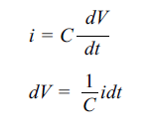
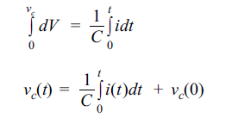




The relation between charge and voltage in a capacitor is written as
Q = CV
We can find the energy stored in a capacitance by integrating this equation. Starting with an
uncharged capacitance (q = 0) and moving charge from one plate to the other until the plates have charge +Q and Q requires the work W.
where W is the energy measured in Joule,
C is the capacitance, measured in Farad,
V is the voltage measured in Volt.

Slide 15
Ohms Law
Ohms law states that the voltage v(t) across a resistor R is directly proportional to the current i(t) flowing through it.
(Or)
Physical states (temperature, material, etc.) of a conductor remaining constant, the current flowing through a conductor is directly proportional to the potential difference across the two ends of the conductor.
(or)
At constant temperature, the current flowing through a conductor is directly proportional to the potential difference across the two ends of the conductor.
V = I R

Slide 16
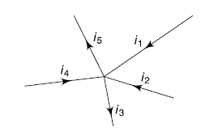

Kirchhoff's Current Law (KCL)
based on the principle of conservation of charge.
it is defined as the algebraic sum of the currents meeting at a point is zero,. i.e., at a node, ∑ I_{n} = 0, where I_{n} are the currents in the branches meeting at the node.
This is also sometimes stated as the sum of the currents entering a node is equal to the sum of the currents leaving the node.
Entering the node is taken as positive direction
Leaving the node is taken as Negative direction

Slide 17
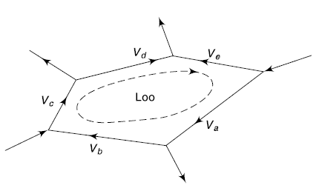

Kirchhoff's Voltage Law (KVL)
based on the principle of conservation of energy
The algebraic sum of the potential differences taken round a closed loop is zero.
i. e., around a loop, ∑ Vn = 0, where Vn are the voltages across the branches in the loop.
This is also sometimes stated as the sum of the emfs taken around a closed loop is equal to the sum of the voltage drops around the loop.

Slide 18
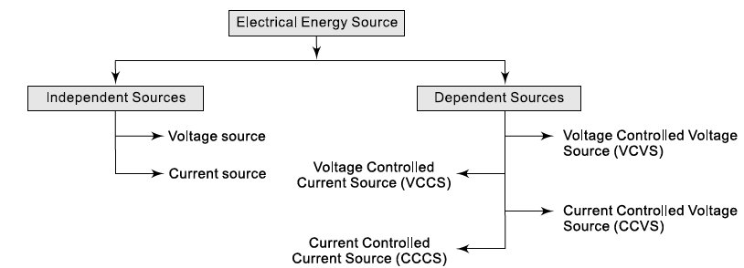
Sign Conventions for applying Kirchhoffs Laws
1. When tracing through a voltage source from positive to negative terminal, the voltage should be given a positive sign.
2. When tracing through a voltage source from negative to positive terminal, the voltage should be given a negative sign.
3. When tracing through a resistance in the direction of current flow, the voltage should be given a positive sign.
4. When tracing through a resistance in a direction opposite to the direction of current flow, the voltage should be given a negative sign.
TYPES OF ELECTRICAL ENERGY SOURCES

Slide 19
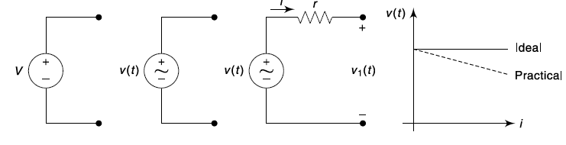
Independent Voltage Source: An ideal voltage source has the following features.
(i) It is a voltage generator whose output voltage remains absolutely constant whatever be the value of the output current.
(ii) It has zero internal resistance so that voltage drop in the source is zero.
(iii) The power drawn by the source is zero.
In practical, the voltage does not remain constant, but falls slightly. This is taken care of by
connecting a small resistance (r) in series with the ideal source. In this case, the terminal voltage will be, v1(t) = v(t) – ir i.e., it will decrease with increase in current i.
An ideal voltage source is not practically possible. No voltage source can maintain its terminal voltage constant even when its terminals are short-circuited. The terminal voltage of a practical voltage source decreases as the load current increases. The v-i characteristics of an ideal and practical voltage source are shown in Fig. A dc or ac generator or batteries are some examples of independent voltage sources. A lead-acid battery and a dry-cell are some examples of constant voltage source which can produce constant terminal voltage within a specified range of output current.

Slide 20
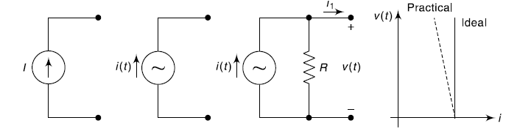

Independent Current Source: An ideal current source has the following features.
(i) It produces a constant current irrespective of the value of the voltage across it.
(ii) It has infinity resistance.
(iii) It is capable of supplying infinity power.
In practice, the output current does not remain constant but decreases with increase in voltage. So, a practical current source is represented by an ideal current source in parallel with a high resistance (R) and the output current becomes,
Similar to voltage sources, an ideal current source is not practically possible. No current source can maintain constant current even when its terminals are open-circuited. The output current of a practical current source decreases as the output voltage increases. The v-i characteristics of an ideal and practical current source are shown in Fig. A solar cell, which can produce constant current within a specified range of output voltage, is an example of independent current source. A natural lightning can be considered to be an ideal current source.

Slide 21
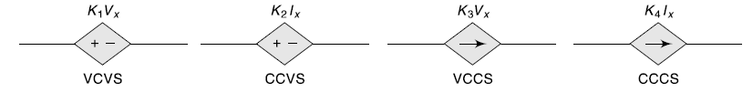
Dependent Sources: In dependent sources (also referred as controlled sources), the source voltage or current is not fixed, but is dependent on a voltage or current at some other location in the circuit. Thus, there are four types of dependent sources.
(a) Voltage Controlled Voltage Source (VCVS)
(b) Current Controlled Voltage Source (CCVS)
(c) Voltage Controlled Current Source (VCCS)
(d) Current Controlled Current Source (CCCS)
Dependent sources are unilateral, because for a voltage controlled voltage source, say, v2 = kv1, the output voltage v2 is controlled by the input voltage v1, but the output current i2 has no influence on the input v1.
Application in electronic systems that uses either the transistors or vacuum tubes needs dependent sources.

Slide 22

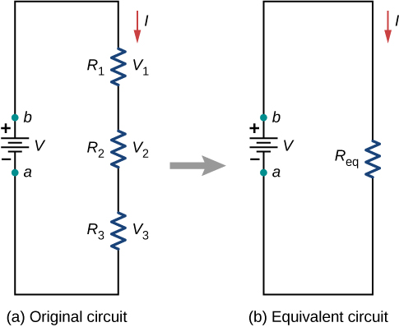



Resistors in Series
If several resistors are connected together and connected to a battery, the current supplied by the battery depends on the equivalent resistance of the circuit. The equivalent resistance of a combination of resistors depends on both their individual values and how they are connected. The simplest combinations of resistors are series and parallel connections
In a series circuit , the output current of the first resistor flows into the input of the second resistor; therefore, the current is the same in each resistor.
In series circuit:
Total current is same in all resistors
Voltage drops are additive
Powers are additive
Equivalent Resistance is increased

Slide 23

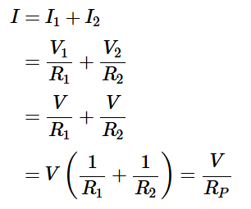
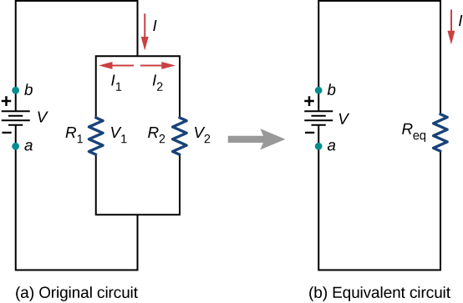

Resistors in Parallel
Resistors are in parallel when one end of all the resistors are connected by a continuous wire of negligible resistance and the other end of all the resistors are also connected to one another through a continuous wire of negligible resistance. The potential drop across each resistor is the same. Current through each resistor can be found using Ohm ’s law I=V/R,
In a Parallel circuit , the voltage is the same across each resistor.
In Parallel circuit:
Voltage is same in all resistors
Currents are additive
Equivalent Resistance is decreased

Slide 24
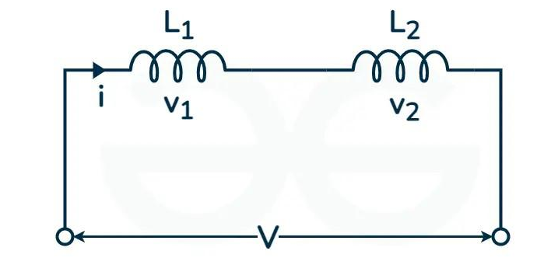
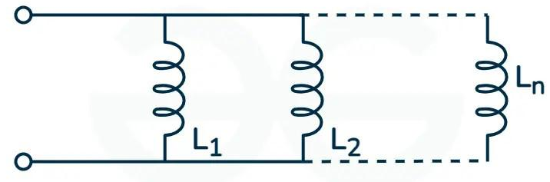
Inductors in Series
Inductors in Parallel
v = v₁ + v₂
i = i₁ + i₂
i_{L} = 1 / L ∫V.dt
v1 = L1 .di/dt
i = 1 / L₁ ∫V.dt + 1 / L₂ ∫V.dt
v2 = L2 .di/dt
i = 1 / L_{eq} ∫V.dt
v = L₁ .di /dt + L₂.di /dt = (L₁ + L₂) .di/dt
1 / L_{eq} ∫V .dt = 1 / L₁ ∫V.dt + 1 / L₂ ∫V.dt
∴ 1 / L_{eq} = 1 / L₁ + 1 / L₂
v = L_{eq}. di /dt
(L₁ + L₂) .di /dt = L_{eq}. di /dt ∴ L_{eq} = L₁ + L₂
Clearly, for N inductors we can say that
1 / L_{eq} = 1 / L₁ +1 / L₂ + 1 / L₃ .....................+ 1 / L_{n}
Clearly, for N inductors we can say that
L_{eq}= L₁+ L₂+ L₃+.......L_{n}

Slide 25
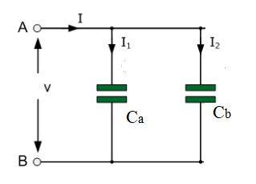
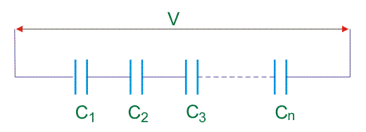





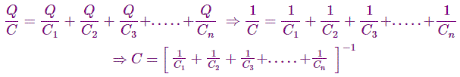




Capacitors in Parallel
Capacitors in Series

Slide 26
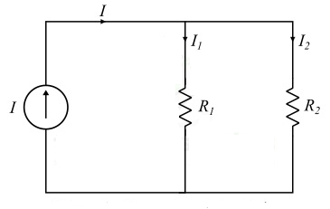








Current Division Rule

Slide 27
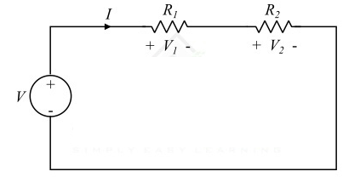









Voltage Division Rule

Slide 28
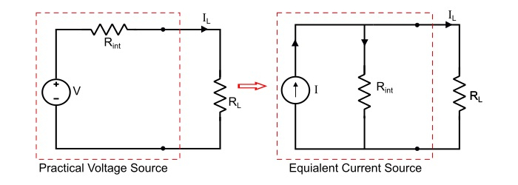
Source Transformation Technique
An electrical source transformation (or just ”source transformation”) is a method for simplifying circuits by replacing a voltage source with its equivalent current source, or a current source with its equivalent voltage source.
Voltage to Current Source Transformation
Consider a practical voltage of V volts having a series internal resistance R_{int} ohms. A load resistance of R_{L} ohms is connected across the load terminals.

Slide 29




Therefore, by referring the circuit of practical voltage source, the load current is
Thus, a practical voltage source of constant voltage V and internal resistance R_{int} is equivalent to a current source of current I = V/R_{int} and internal resistance R_{int} in parallel with current source.
Here, the internal resistance of the equivalent current source has the same value as the internal resistance of the voltage source.

Slide 30
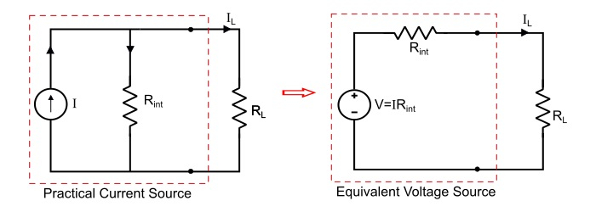





Current to Voltage Source Transformation
Consider a practical current source of constant current I amperes with a parallel internal resistance R_{int}, it can be converted into an equivalent voltage source as follows.
Therefore, a current source can be converted into an equivalent voltage source, where the value of voltage of the equivalent voltage source is V = IR_{int} and the series resistance R_{int} of voltage source has the same value as the parallel resistance of the current source.

Slide 31
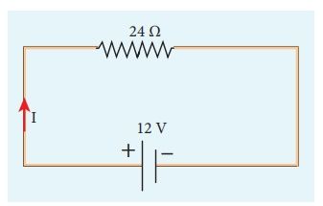
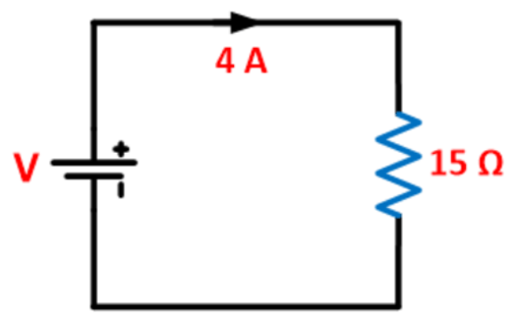
Problems on Resistance and Ohm’s Law
A potential difference across 24 Ω resistor is 12 V. What is the current through the resistor?
V = 12 V and R = 24 Ω
Current, I = ?
From Ohm’s law, I = V/R = 12/24 = 0 .5 A
As shown in the circuit below, a current of 4 A is flowing through the resistance of 15 Ω. Determine the voltage drop across the circuit using ohm’s law.
V = 4 * 15 = 60V

Slide 32

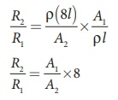
Problems on Resistance and Ohm’s Law
The resistance of a wire is 20 Ω. What will be new resistance, if it is stretched uniformly 8 times its original length?
R1 = 20 Ω, R2= ?
Let the original length (l1) be l.
The new length, l2 = 8l1 (i.,e) l2 =8l
The original resistance, R = ρ [ l1 / A1]
The new resistance
Though the wire is stretched, its volume is unchanged.
Initial volume = Final volume
A1l1= A2l2 , A1l = A28l
A1 / A2 = 8l / l = 8
By dividing equation R2 by equation R1, we get
Substituting the value of A1/A2, we get
R2 / R1 = 8 ×8 = 64 Ω
R2 = 64 × 20=1280 Ω
Hence, stretching the length of the wire has increased its resistance.

Slide 33
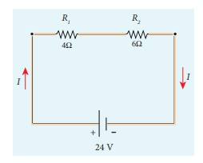
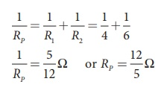
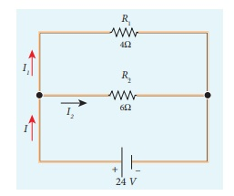
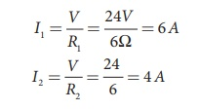
Problems on Equivalent Resistance
Calculate the equivalent resistance for the circuit which is connected to 24 V battery and also find the potential difference across 4 Ω and 6 Ω resistors in the circuit.
Since the resistors are connected in series, the effective resistance in the circuit
= 4 Ω + 6 Ω = 10 Ω
The Current I in the circuit= V/ Req = 24/10 = 2 .4 A
Voltage across 4Ω resistor
V1 = IR1 = 2 . 4 A× 4 Ω = 9.6V
Voltage across 6 Ω resistor
V2 = IR1 = 2 . 4 A× 6 Ω =14 .4V
Calculate the equivalent resistance in the following circuit and also find the current I, I1 and I2 in the given circuit.
I = I1 + I2= 6 A + 4 A = 10 A

Slide 34
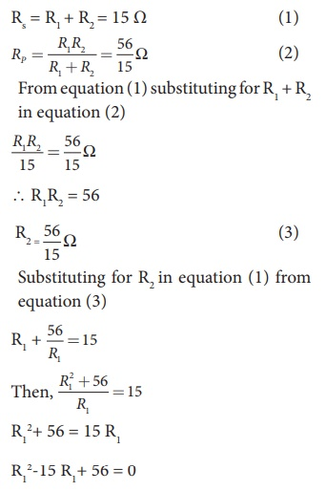
When two resistances connected in series and parallel their equivalent resistances are 15 Ω and 56/15 Ω respectively. Find the individual resistances.
(R1– 8) (R1– 7) = 0
If (R1= 8 Ω)
using in equation (1)
8 + R2 = 15
R2 = 15 – 8 = 7 Ω ,
R2 = 7 Ω i.e , (when R1 = 8 Ω ; R2 = 7 Ω)
If (R1= 7 Ω)
Substituting in equation (1)
7 + R2 = 15
R2 = 8 Ω , i.e , (when R1 = 8 Ω ; R2 = 7 Ω )

Slide 35

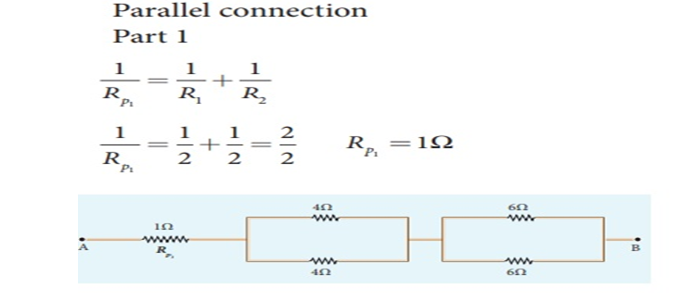
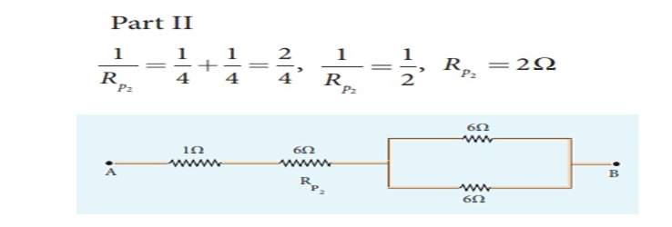
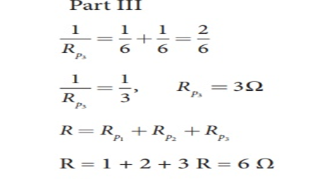
Calculate the equivalent resistance between A and B in the given circuit.

Slide 36
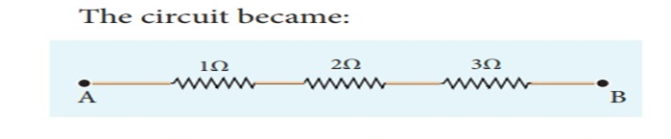

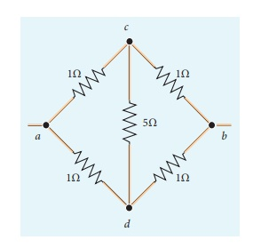
Five resistors are connected in the configuration as shown in the figure. Calculate the equivalent resistance between the points a and b.

Slide 37
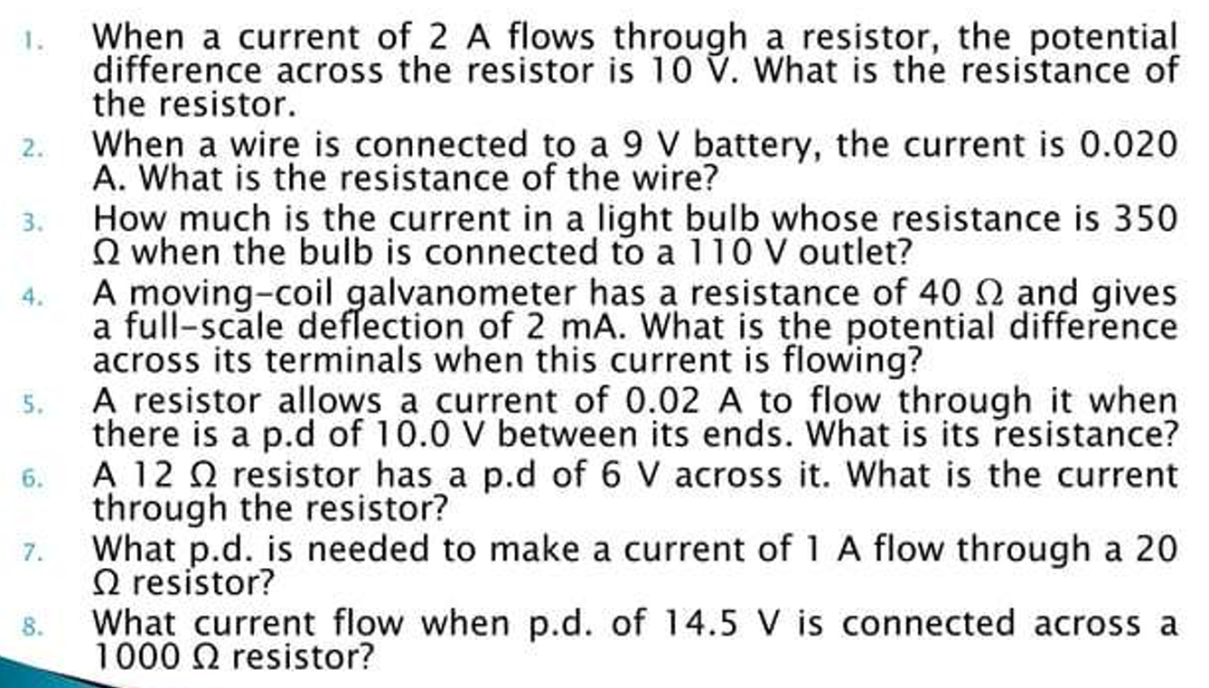
Problems on Resistance and Ohm’s Law

Slide 38
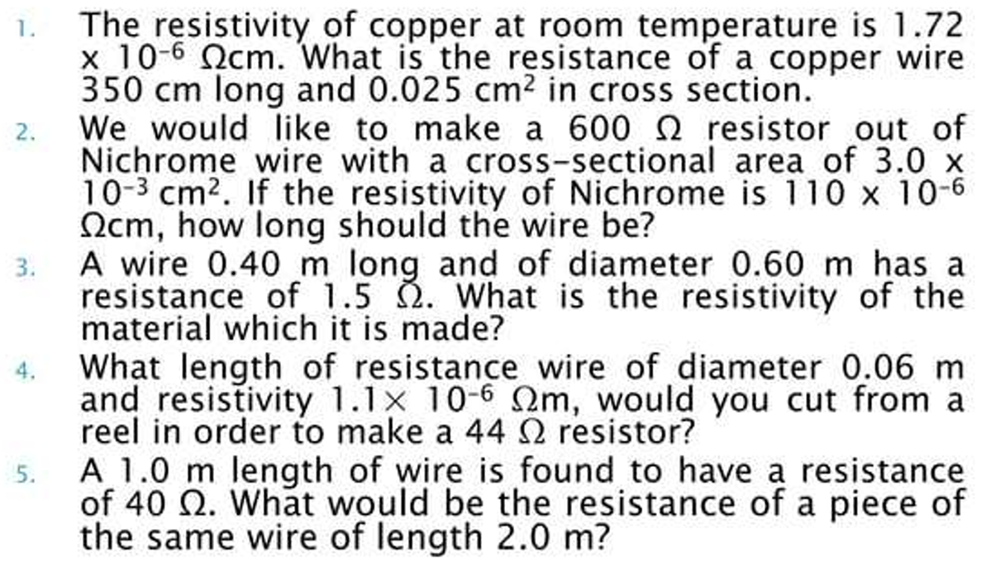

Slide 39
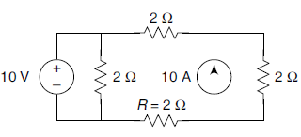
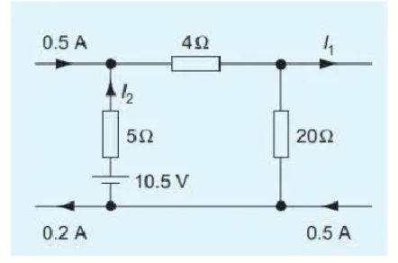
Find the voltage across the resistor R = 2 Ω in the figure
3.33 V
The element of a 500 watt electric iron is designed for use on a 200 volt supply. What value of resistance is needed to be connected in series in order that the iron can be operated from 240 volt supply? [35.2Ω]

Slide 40
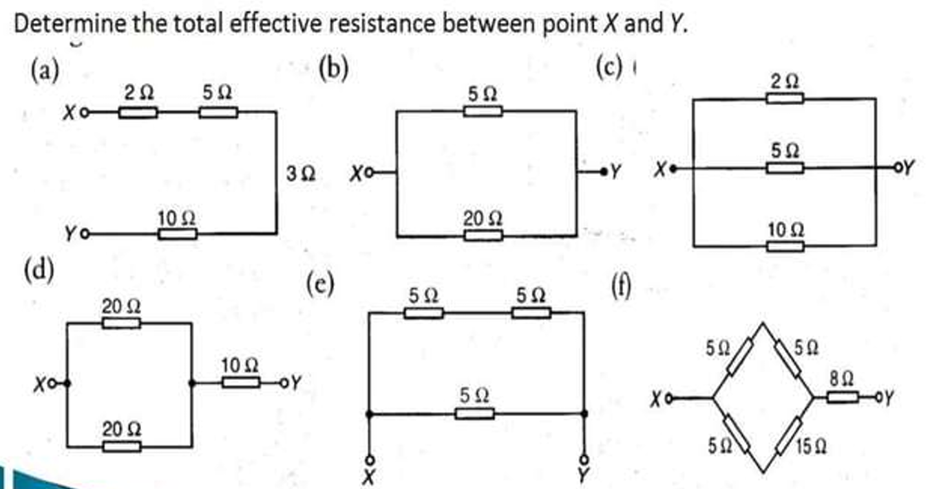

Slide 41
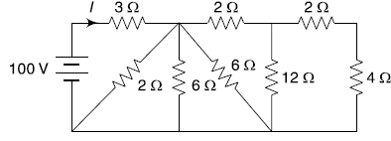
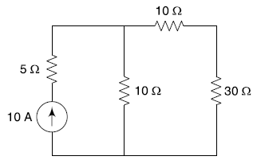
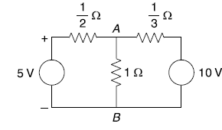
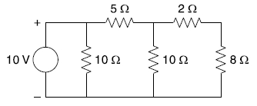
For the circuit shown in figure, the value of current I is
The current through 30 Ω branch in the given circuit is
The potential of the point A in the given network is
The current through 8 Ω branch is

Slide 42
